Slide 1

Certificates, Password Hashing, and Case Studies
CSE 405 January 2025
Lecture 8

Slide 2
Last Time: Public-Key Encryption and Digital Signatures
Public-key cryptography: Two keys; one undoes the other
Public-key encryption: One key encrypts, the other decrypts
Security properties similar to symmetric encryption
ElGamal: Based on Diffie-Hellman
The public key is g^{b}, and C1 is g^{r}.
Not IND-CPA secure on its own
RSA: Produce a pair e and d such that M^{ed} = M mod N
Not IND-CPA secure on its own
Hybrid encryption: Encrypt a symmetric key, and use the symmetric key to encrypt the message
Digital signatures: Integrity and authenticity for asymmetric schemes
RSA: Same as RSA encryption, but encrypt the hash with the private key

Slide 3
Today
Certificates: How do we distribute public keys securely?
Password Hashing: How do we securely store passwords?
Case studies
How can we discover bad cryptography?
How do we securely send messages in practice?
How can we report abusive behavior?

Slide 4
Certificates
Textbook Chapter 13

Slide 5
Review: Public-Key Cryptography
Public-key cryptography is great! We can communicate securely without a shared secret
Public-key encryption: Everybody encrypts with the public key, but only the owner of the private key can decrypt
Digital signatures: Only the owner of the private key can sign, but everybody can verify with the public key
What’s the catch?

Slide 6
Problem: Distributing Public Keys
Public-key cryptography alone is not secure against man-in-the-middle attacks
Scenario
Alice wants to send a message to Bob
Alice asks Bob for his public key
Bob sends his public key to Alice
Alice encrypts her message with Bob’s public key and sends it to Bob
What can Mallory do?
Replace Bob's public key with Mallory’s public key
Now Alice has encrypted the message with Mallory’s public key, and Mallory can read it!

Slide 7
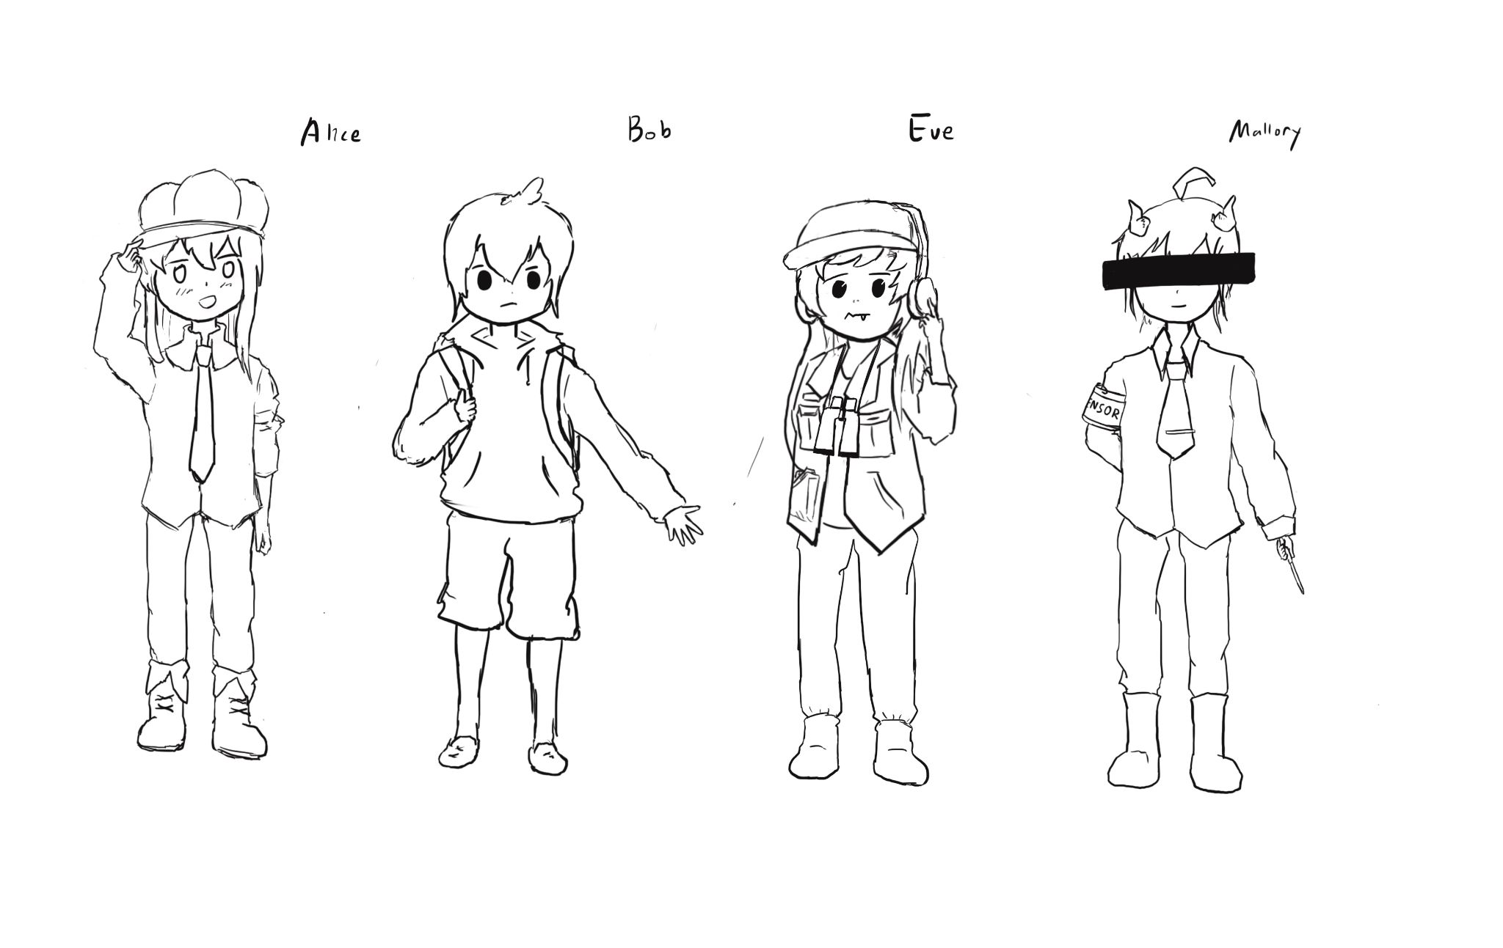
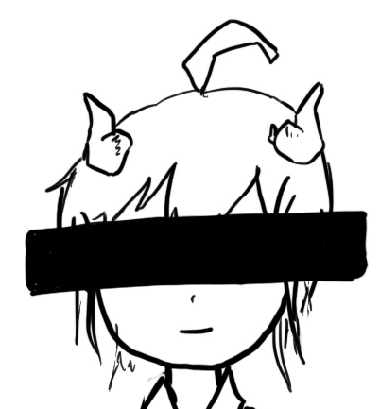
Problem: Distributing Public Keys
Alice
Mallory
Bob
Generate PKB, SKB
Send PKB
Send PKM
Receive PKM
Send {M}PKM
Decrypt {M}PKM
Send {M}PKB
Decrypt {M}PKB

Slide 8
Problem: Distributing Public Keys
Idea: Sign Bob’s public key to prevent tampering
Problem
If Bob signs his public key, we need his public key to verify the signature
But Bob’s public key is what we were trying to verify in the first place!
Circular problem: Alice can never trust any public key she receives
You cannot gain trust if you trust nothing. You need a root of trust!
Trust anchor: Someone that we implicitly trust
From our trust anchor, we can begin to trust others

Slide 9
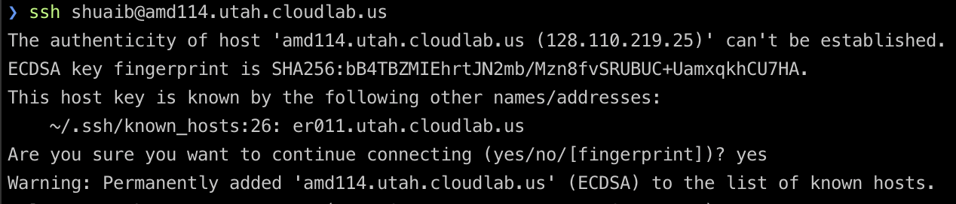
Trust-on-First-Use
Trust-on-first-use: The first time you communicate, trust the public key that is used and warn the user if it changes in the future
Used in SSH and a couple other protocols
Idea: Attacks aren’t frequent, so assume that you aren’t being attacked the first time communicate
Also known as “Leap of Faith”

Slide 10
Certificates
Certificate: A signed endorsement of someone’s public key
A certificate contains at least two things: The identity of the person, and the key
Abbreviated notation
Encryption under a public key PK: {“Message”}PK
Signing with a private key SK: {“Message”}SK⁻¹
Recall: A signed message must contain the message along with the signature; you can’t send the signature by itself!
Scenario: Alice wants Bob’s public key. Alice trusts EvanBot (PKE, SKE)
EvanBot is our trust anchor
If we trust PKE, a certificate we would trust is {“Bob’s public key is PKB”}SKE⁻¹
Notes:
Ask: Why not just Sign

Slide 11
Attempt #1: The Trusted Directory
Idea: Make a central, trusted directory (TD) from where you can fetch anybody’s public key
The TD has a public/private keypair PKTD, SKTD
The directory publishes PKTD so that everyone knows it (baked into computers, phones, OS, etc.)
When you request Bob’s public key, the directory sends a certificate for Bob’s public key
{“Bob’s public key is PKB”}SKTD⁻¹
If you trust the directory, then now you trust every public key from the directory
What do we have to trust?
We have received TD’s key correctly
TD won’t sign a key without verifying the identity of the owner
Notes:
Ask at the end of the slide: What are some problems with this?

Slide 12

Attempt #1: The Trusted Directory
Problems: Scalability
One directory won’t have enough compute power to serve the entire world
Problem: Single point of failure
If the directory fails, cryptography stops working
If the directory is compromised, you can’t trust anyone
If the directory is compromised, it is difficult to recover
…….
…….
TD
Give me Alice’s public key
Give me Bob’s public key

Slide 13
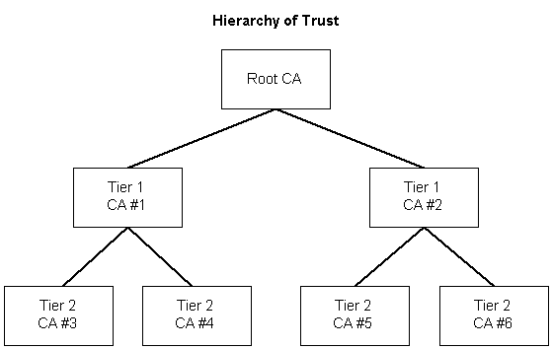
Certificate Authorities
Addressing scalability: Hierarchical trust
The roots of trust may delegate trust and signing power to other authorities
Top of the hierarchy: (root certificate authority, or root CA)
CA#1 and CA#2 receive delegated trust (intermediate CAs)

Slide 14
Certificate Authorities
Addressing scalability: Multiple trust anchors
There are ~150 root CAs who are implicitly trusted by most devices
Public keys are hard-coded into operating systems and devices
Each delegation step can restrict the scope of a certificate’s validity
Creating the certificates is an offline task: The certificate is created once in advance, and then served to users when requested

Slide 15
Revocation
What happens if a certificate authority messes up and issues a bad certificate?
Example: {“Bob’s public key is PKM”}SKCA⁻¹
Example: Verisign (a certificate authority) accidentally issued a certificate saying that an average Internet user’s public key belonged to Microsoft

Slide 16
Revocation: Expiration Dates
Approach #1: Each certificate has an expiration date
When the certificate expires, request a new certificate from the certificate authority
The bad certificate will eventually become invalid once it expires
Benefits
Mitigates damage: Eventually, the bad certificate will become harmless
Drawbacks
Adds management burden: Everybody has to renew their certificates frequently
If someone forgets to renew a certificate, their website might stop working
Tradeoff: How often should certificates be renewed?
Frequent renewal: More secure, less usable
Infrequent renewal: Less secure, more usable
LetsEncrypt (a certificate authority) chose very frequent renewal
It turns out frequent renewal is more usable: It forces automated renewal instead of a once-every 3 year task that gets forgotten!

Slide 17
Revocation: Announcing Revoked Certificates
Approach #2: Periodically release a list of invalidated certificates
Users must periodically download a Certification Revocation List (CRL)
How do we authenticate the list?
The certificate authority signs the list!
{“The certificate with serial number 0xdeadbeef is now revoked”}SKCA⁻¹
Drawbacks
Lists can get large
Mitigated by shorter expiration dates (don’t have to list them once they expire)
Until a user downloads a list, they won’t know which certificates are revoked
What happens if the certificate authority is unavailable?
Fail-safe default: Assume all certificates are invalid? Now we can’t trust anybody!
Possible attack: Attacker forces the CA to be unavailable (denial of service attack)
Use old list: Potentially dangerous if the old list is missing newly revoked certificates

Slide 18
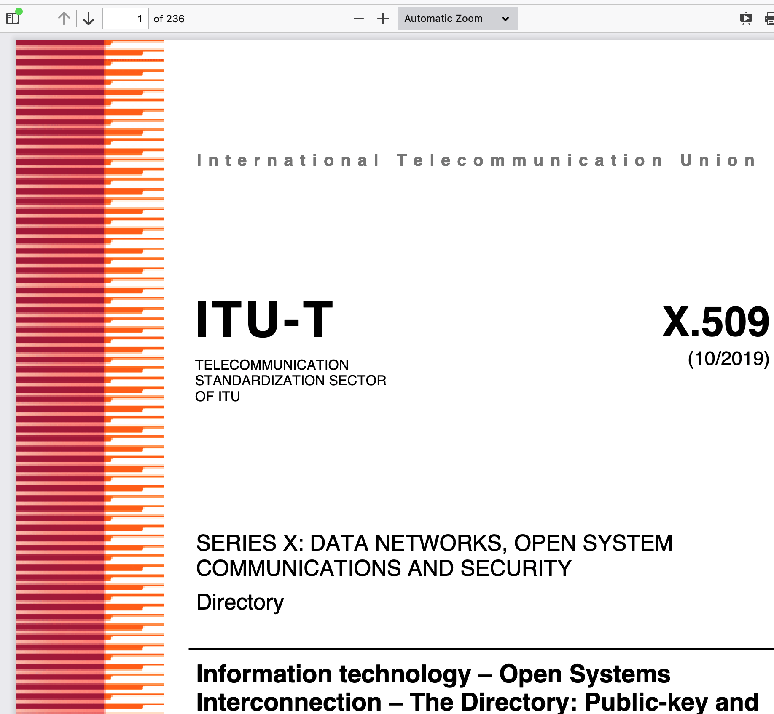
Certificates: Complexity
Certificate protocols can get very complicated
Example: X.509 is incredibly complicated (a 236 page standard!) because it tried to do everything
Notes:
https://tools.ietf.org/html/rfc5280

Slide 19
Alternative: Web of Trust
Modern public-key infrastructures are structured like trees
Originally, public-key infrastructures looked like graphs instead
Everybody can issue certificates for anyone else
Example: Alice signs Bob’s key. Bob signs Carol’s key. If Dave trusts Alice, he trusts Bob and Carol.
Benefit: You know the trust anchor personally (e.g. because you met them in-person, or because you signed their key)
Problem: Graphs get far more complex than trees!
OpenPGP (Pretty Good Privacy) originally used the web of trust model
Key-signing parties: meeting in-person to sign each other’s public keys
It quickly proved to be a disaster
Instead, everyone just relies on MIT’s central keyserver which is broken!
Takeaway: Trust anchors make public-key infrastructures much simpler!

Slide 20
Summary: Certificates
Certificates: A signed attestation of identity
Trusted directory: One server holds all the keys, and everyone has the TD’s public key
Not scalable: Doesn’t work for billions of keys
Single point of failure: If the TD is hacked or is down, cryptography is broken
Certificate authorities: Delegated trust from a pool of multiple root CAs
Root CAs can sign certificates for intermediate CAs
Revocation: Certificates contain an expiration date
Revocation: CAs sign a list of revoked certificates

Slide 21
Password Hashing
Textbook Chapter 14

Slide 22
Review: Cryptographic Hashes
Hashes accept arbitrarily large inputs
Hashes “look” random
Change a single bit on the input and each output bit has a 50% chance of flipping
And until you change the input, you can't predict which output bits are going to change
The ones we talked about are fast
Can operate at many many MB/s: Faster at processing data than block ciphers
Recall: Security properties
One way: Given an output y, it is infeasible to find any input x such that H(x) = y.
Collision resistant: It is infeasible to find another any pair of inputs x' ≠ x such that H(x) = H(x').

Slide 23
Storing Passwords
Password: A secret string a user types in to prove their identity
When you create an account with a service: Create a password
When you later want to log in to the service: Type in the same password again
How does the service check that your password is correct?
Bad idea #1: Store a file listing every user’s password
Problem: What if an attacker hacks into the service? Now the attacker knows everyone’s passwords!
Bad idea #2: Encrypt every user’s password before storing it
Problem: The attacker could steal the passwords file and the key and decrypt everyone’s passwords!
We need a way to verify passwords without storing any information that would allow someone to recover the original password

Slide 24
Password Hashing
For each user, store a hash of their password
Verification process
Hash the password submitted by the user
Check if it matches the password hash in the file
What properties do we need in the hash?
Deterministic: To verify a password, it has to hash to the same value every time
One-way: We don’t want the attacker to reverse hashes into original passwords

Slide 25
Password Hashing: Attacks
What if two different users decide to use password123 as their password?
Hashes are deterministic: They’ll have the same password hash
An attacker can see which users are using the same password
Brute-force attacks
Most people use insecure, common passwords
An attacker can pre-compute hashes for common passwords: H("password123"), H("password1234"), H("1234567890"), etc.
Dictionary attack: Hash an entire dictionary of common passwords
Rainbow tables: An algorithm for computing hashes that makes brute-force attacks easier

Slide 26
Salted Hashes
Solution #1: Add a unique, random salt for each user
Salt: A random, public value designed to make brute-force attacks harder
For each user, store: username, salt, H(password || salt)
To verify a user: look up their salt in the passwords file, compute H(password || salt), and check it matches the hash in the file
Salts should be long and random
Salts are not secret (think of them like nonces or IVs)
Brute-force attacks are now harder
Assume there are M possible passwords and N users in the database
Unsalted database: Hash all possible passwords, then lookup all users’ hashes ⇒ O(M + N)
Salted database: Hash all passwords for each user’s salt ⇒ O(MN)

Slide 27
Slow Hashes
Solution #2: Use slower hashes
Cryptographic hashes are usually designed to be fast
SHA is designed to produce a checksum of your 1 GB document as fast as possible
Password hashes are usually designed to be slow
Legitimate users only need to submit a few password tries. Users won’t notice if it takes 0.0001 seconds or 0.1 seconds for the server to check a password.
Attackers need to compute millions of hashes. Using a slow hash can slow the attacker by a factor of 1,000 or more!
Note: We are not changing the asymptotic difficulty of attacks. We’re adding a large constant factor, which can have a huge practical impact for the attacker

Slide 28
Slow Hashes: PBKDF2
Password-based key derivation function 2 (PBKDF2): A slow hash function
Setting: An underlying function that outputs random-looking bits (e.g. HMAC-SHA256)
Setting: The desired length of the output (n)
Setting: Iteration count (higher = hash is slower, lower = hash is faster)
Input: A password
Input: A salt
Output: A long, random-looking n-bit string derived from the password and salt
Implementation: Basically computing HMAC 10,000 times
Benefits (assuming the user password is strong)
Derives an arbitrarily long string from the user's password
Output can be directly used as a symmetric key
Output can also be used to seed a PRNG or generate a public/private key pair
Algorithm is slow, but doesn't use a lot of memory (alternatives like Scrypt and Argon2 use more memory)

Slide 29
Offline and Online Attacks
Offline attack: The attacker performs all the computation themselves
Example: Mallory steals the password file, and then computes hashes herself to check for matches.
The attacker can try a huge number of passwords (e.g. use many GPUs in parallel)
Defenses: Salt passwords, use slow hashes
If an attacker can do an offline attack, you need a really strong password (e.g. 7 or more random words)
Online attack: The attacker interacts with the service
Example: Mallory tries to log in to a website by trying every different password. Mallory is forcing the server to compute the hashes.
The attacker can usually only try a few times per second, with no parallelism
Defenses: Add a timeout or rate limit the number of tries to prevent the attacker from trying too many times

Slide 30
Summary: Password Hashing
Store hashes of passwords so that you can verify a user’s identity without storing their password
Attackers can use brute-force attacks to learn passwords (especially when users use weak passwords)
Defense: Add a different salt for each user: A random, public value designed to make brute-force attacks harder
Offline attack: The attacker performs all the computation themselves
Defense: Use salted slow hashes instead of unsalted fast hashes
Online attack: The attacker interacts with the service
Defense: Use timeouts

Slide 31
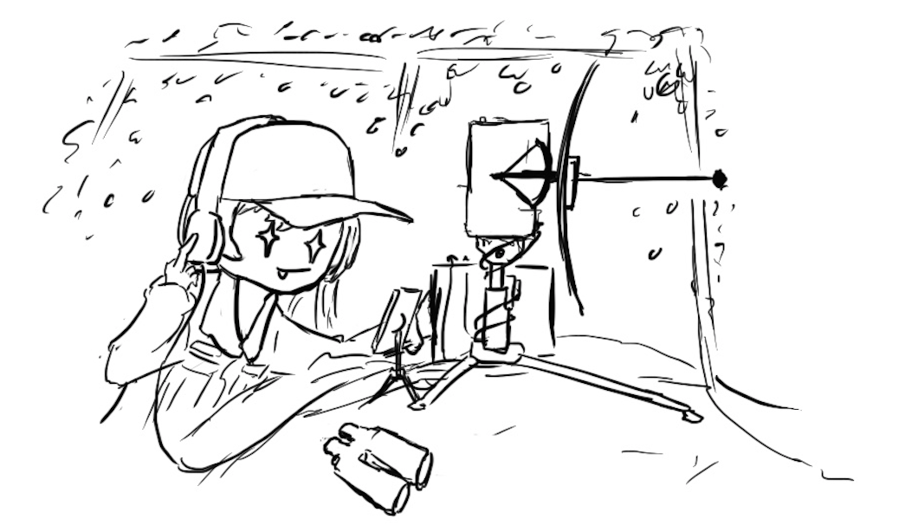
Traffic Analysis & Side Channels

Slide 32
Traffic Analysis & Side Channels
Traffic analysis: Analyzing who is talking to whom and when
The encryption schemes we’ll be studying do not hide the identity of who you’re t​​alking to
The information used for this analysis is often referred to as metadata: Data about the message and its context
Side channels: Information about the plaintext revealed as a result of the implementation of the scheme, not the scheme itself
Modern crypto systems are usually broken through side channels

Slide 33
Traffic Analysis & Side Channels in Practice: Spies
In the 1990s, there were some Russian spies in the US
The TV series “The Americans” was based on this incident
A Cuban number station had a bug: some nights it never broadcasted “9”
Normally, 0–9 would be equally frequent
It turns out this corresponded to when the Russian spies were on vacation
The way that random numbers were generated for cover traffic had a bug in it
The FBI used this as part of their investigation
Takeaway: Secure algorithms can be broken in insecure implementations, leaking information
Notes:
Revealed inadvertently by Struck and analyzed by Matt Blaze
TODO Nick

Slide 34

Nothing-Up-My-Sleeve-Numbers

Slide 35
Nothing-Up-My-Sleeve-Numbers
Cryptography uses a lot of constants
Initial state for SHA
Prime p and generator g in Diffie-Hellman
Parameters for elliptic-curve cryptography (curve equations, points on the curve like P and Q)
ipad and opad in HMAC
Usually, any value could work, but the designer needed to choose some constant for the algorithm
Example: In Diffie-Hellman, any large prime p and generator g works, but there’s a default p and g that everyone uses
Where do these default parameter values come from?

Slide 36
Takeaway: Nothing-Up-My-Sleeve-Numbers
Good systems should clearly and transparently describe how public parameters are generated
Argue about why these values provide good security (e.g. AES designers argued this for the values in their S-boxes)
Choose values with obvious human significance: The developer probably doesn’t have millions of values of obvious significance to brute-force and pick a value with a backdoor
Seed a PRNG with your name
The first few digits of π
0x67452301, 0xefcdab89, … (SHA-1)
Fractional parts of the square/cube roots of prime numbers (SHA-2)

